Slide 1

Fundamentals of C Language
By Sharanam Chotai

Slide 2
Programming Language
Syntax:
Set of rules
Semantics:
Meaning of the syntax
Compilation/Interpretation:
Translation to Machine Language
Automation:
Repetitive and complex tasks.
Problem-Solving:
Focus on solution, not on tools.

Slide 3
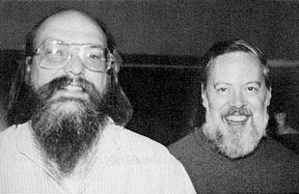
C language
Closer to real hardware
To create OS (Unix in 1969) by Dennis Ritchie at the Bell Laboratories in 1972
Procedural programming language (general-purpose)
Ken Thompson & Dennis Ritchie

Slide 4
Programming Paradigm
Way of thinking about and structuring code
“Most programming languages support multiple paradigms. A programmer's growth involves learning to choose the appropriate programming language and paradigm for the situation.”
- Mooc.fi

Slide 5
C as a procedural language:
Function-based
Sequential execution
Structured programming

Slide 6
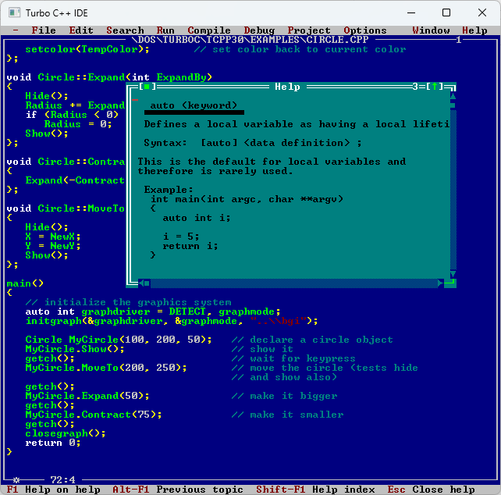
Required Tools
Operating System
Text Editor
Compiler
Executable

Slide 7
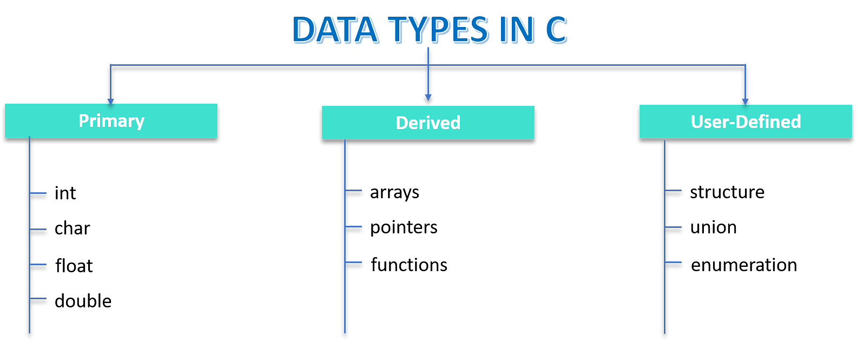

Slide 8
Types of Operators
Arithmetic Operators: +, -, *, /, %, ++, --
Relational Operators: ==, !=, >, <, >=, <=
Logical Operators: &&, ||, !
Bitwise Operators: &, |, ^, ~, <<, >>
Assignment Operators: =, +=, -=, *=, /=, %=, <<=, >>=, &=, |=, ^=
Conditional Operator: ?:
Cast Operator: (type)
Comma Operator: ,
Address Operator: &
Dereference Operator: * (also known as Indirection Operator or Value at Address Operator)

Slide 9
Decision Making Statements
if statement
if-else statement
nested if-else statement
else-if ladder
switch statement

Slide 10
Looping statements
Branching statements
for
while
do…while
break
continue

Slide 11
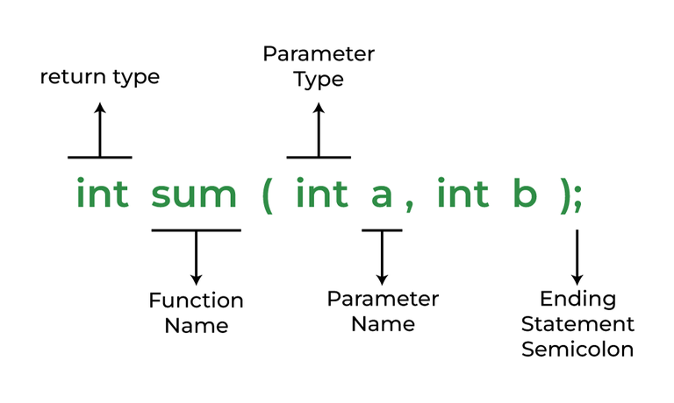
Function in C
Block of code which only runs when it is called
Aspects of using function
Function Declaration
Function Definition
Function Calls
Type of arguments:
Pass by Value
Pass by Reference

Slide 12
Quiz time
What is the return type of scanf and printf functions?
What is the difference between = and == in C?
int a = 5, b = 10; printf("%d", a++ + ++b);
Which loop is also called exit-controlled loop?

